Slide 1

Stabilized-RED
Md. Zarif Ul Alam
1705010

Slide 2
Reference
T. J. Ott, T. V. Lakshman and L. H. Wong, "SRED: stabilized RED," IEEE INFOCOM '99.

Slide 3
Methodology
Zombie List : M recently seen flows, with extra information “count” and “time stamp”
Zombies : flows in the zombie list
Zombie list starts out empty, As packets arrive, as long as the list is not full, for every arriving packet the packet flow identifier (source address, destination address, etc.) is added to the list, the count of that zombie is set to zero, and its timestamp is set to the arrival time of the packet

Slide 4
Methodology
Once the zombie list is full it works as follows: Whenever a packet arrives, it is compared with a randomly chosen zombie in the zombie list.
Hit : If the arriving packet’s flow matches the zombie we declare a “hit”.
Count ++
Update timestamp
No Hit : If the two are not of the same flow, we declare a “no hit”. In that case, with probability p the flow identifier of the packet is overwritten. With probability 1 - p there is no change to the zombie list.

Slide 5
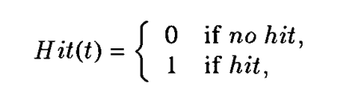
Hit

Slide 6
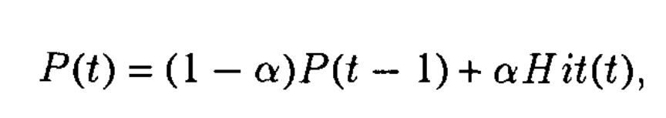
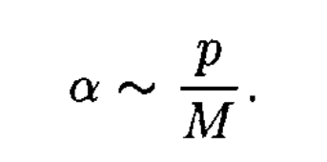

HitFrequency
where
$p$ = probability that in case of a “non-hit” the incoming flow overwrites the zombie it is compared with
$M$ = number of flows recently seen or size of zombie list
$p$ = 0.25 and $M$ = 1000 for this paper

Slide 7
Drop Mode
Irrespective of whether there was a hit or not, the packet may be dropped if the buffer occupancy is such that the system is in random drop mode.

Slide 8
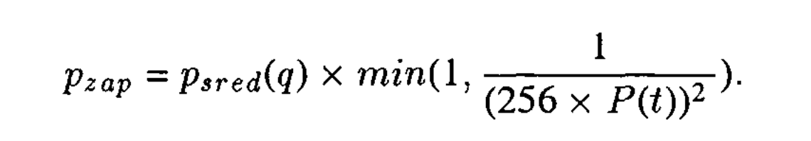
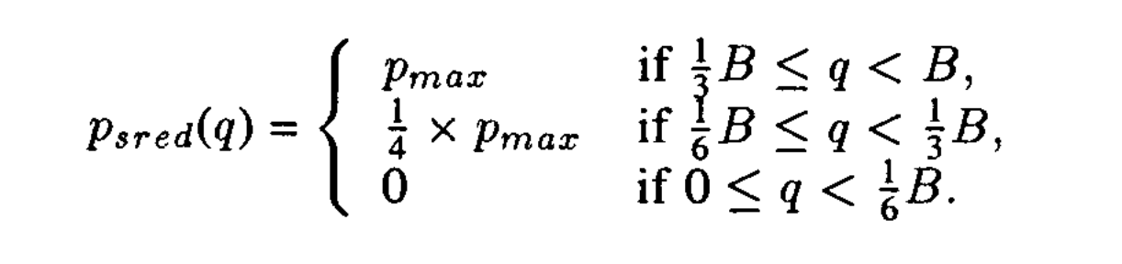

Drop Probability Function
where
$p_{max}=$0.15 , doesn’t perform well if outside [0.09,0.15]
$B=$Buffer Capacity

Slide 9
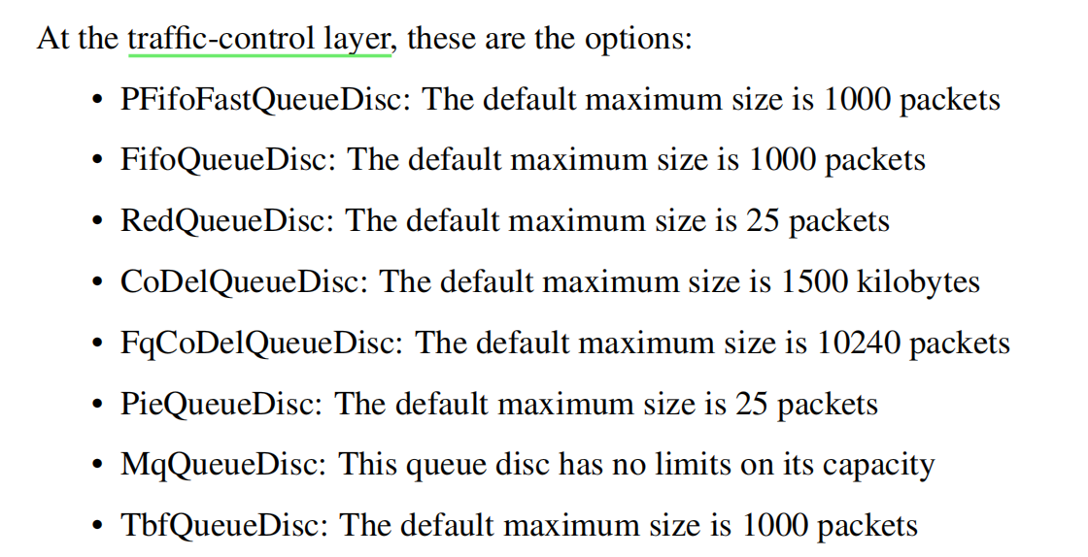
Available queuing models in ns3 codebase

Slide 10
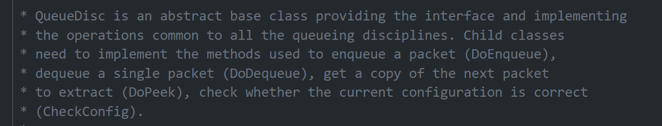
A look at QueueDisc

Slide 11
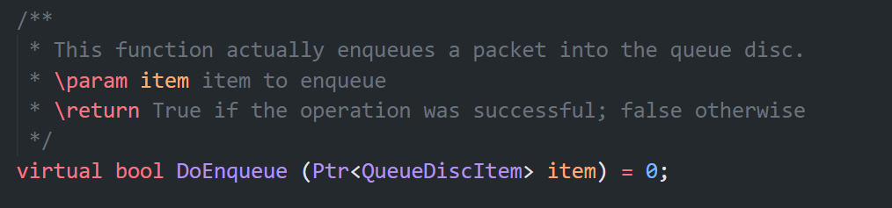
DoEnqueue

Slide 12
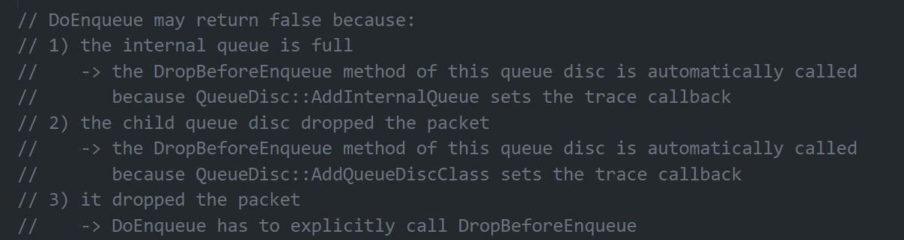
DoEnqueue

Slide 13
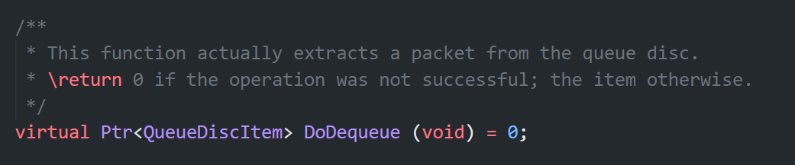
DoDequeue

Slide 14
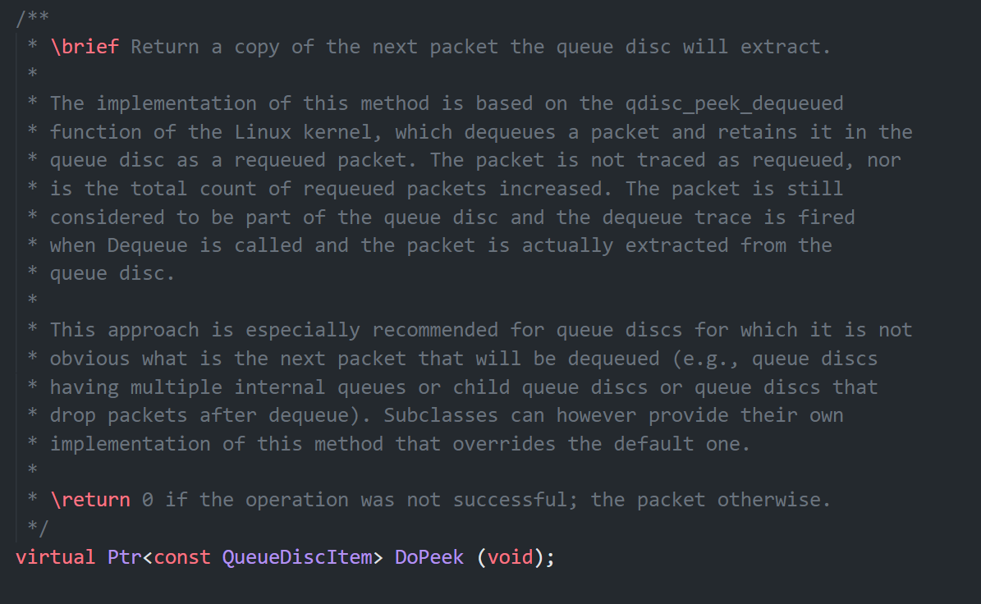
DoPeek

Slide 15
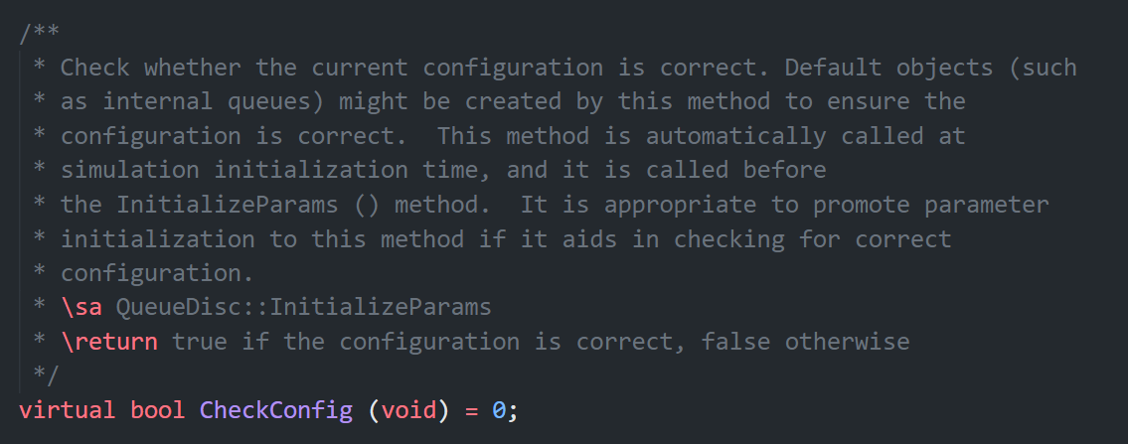
CheckConfig

Slide 16
Code
src/traffic-control/model/queue-disc.h
src/traffic-control/model/queue-disc.cc

Slide 17
THANK YOU

